Slide 1
Touch Less Touch Screens
Submitted By : NABARUN SAMADDAR
MSC 4th sem
Roll no : 115/ CSC/ 181007
Reg no : 223 -1122 -0098 -14
Surendranath College, University of Calcutta

Slide 2
Contents
Introduction
What is Touch Screens
History
Issues With Touch Screens
What is Touch Less Touch Screens
How it works
Workflow
SDK
Application Fields
Devices
Advantages
Disadvantages
Conclusion
Acknowledgement
Bibliography

Slide 3
Introduction
The touchless touch screen sounds like it would to nice and easy but it is quite a workout. This unique screen is made by TouchKo, white electronics designs, and Groupe 3D. The screen resembles the Nintendo wii without a wii controller.
With the touchless touchscreen your hand doesn’t have to come in contact with the screen at all, it works by detecting your hand movements in the air. Now this technology doesn’t compare to the hologram like IOT technologies.
You may probably see this screen in stores because the main advantage of this technology is, This technology doesn’t require de-sanitization.
All thanks to elliptic labs for developing this kind of technology.

Slide 4
What is Touch Screens
A touchscreen, or touch screen, is a both input and output device and normally layered on the top of an electronic visual display of an information processing system.
A user can give input or control the information processing system through simple or multi-touch gestures by touching the screen with a special stylus or one or more fingers.

Slide 5
History
E.A. Johnson of the Royal Radar Establishment, Malvern described his work on capacitive touch screens in a short article published in 1965 and then more fully – with photographs and diagrams – in an article published in 1967.
In 1982, the first human control multi touch device was developed at the University of Toronto by Nimish Mehta. It was not so much a touch screen as it was a touch tablet.
Bill Buxton has played a huge role in developing multi touch screen technology at Bell Labs in 1984.
TouchKo, White electronics, Groupe 3D and elliptic Labs are putting their continuous efforts to make a user friendly Touchless touchscreen technology.

Slide 6
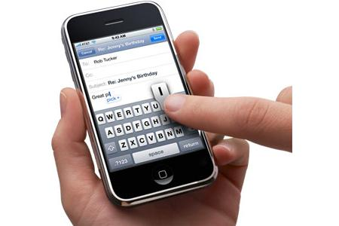
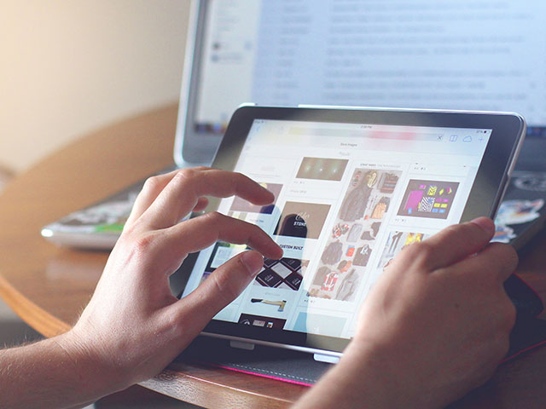
Examples
Resistive
Capacitive

Slide 7
Issues With Touch Screen
Accuracy
Huge Repairing Cost
Pocket Dial
Scratches
Gets Dirty
Non hygienic

Slide 8
What is Touch Less Touch Screens
The Touch less Touchscreen can be defined as a technology where the finger motions are utilized without any need to touch the screen. In simple words, it works through hand wave or hand gesture in particular directions or a hand flick in a certain area.
We can simply call it as GBUI system or Gesture Based User Interface system.
There are two ways of implementing this technology. Such as, Ultrasound wave and motion detection through sensor.

Slide 9
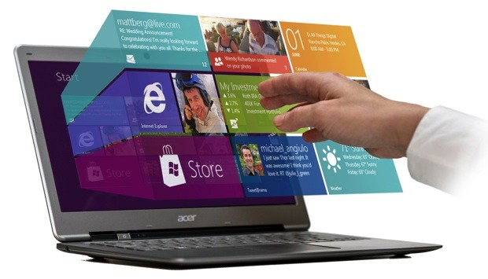
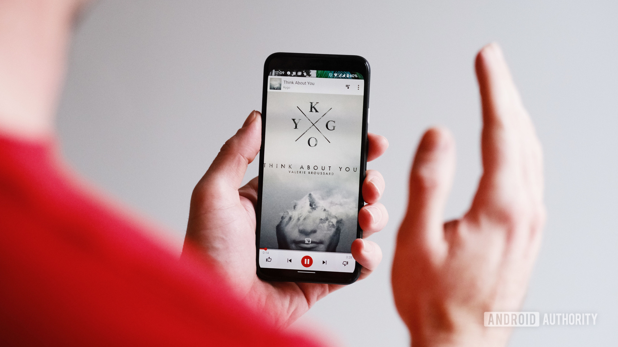
Examples

Slide 10
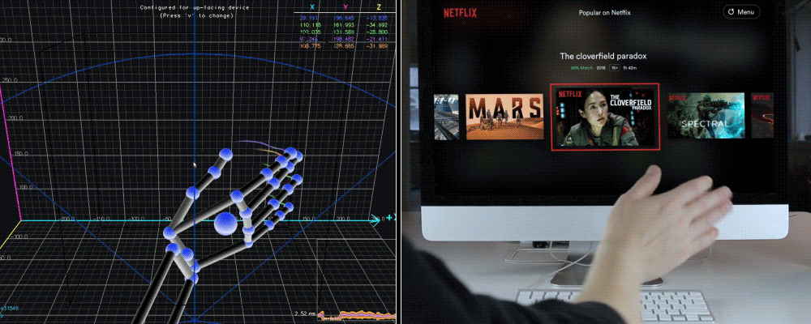
Examples

Slide 11
How It Works
Movement Detection
Optical Pattern Recognition
Motion Pattern Interruption
Screen Pointing

Slide 12
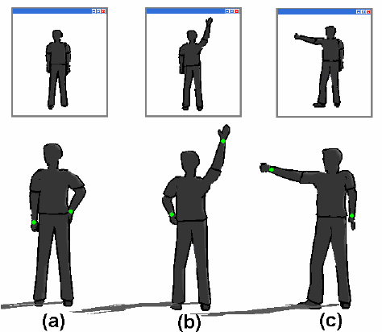
Movement Detection

Slide 13
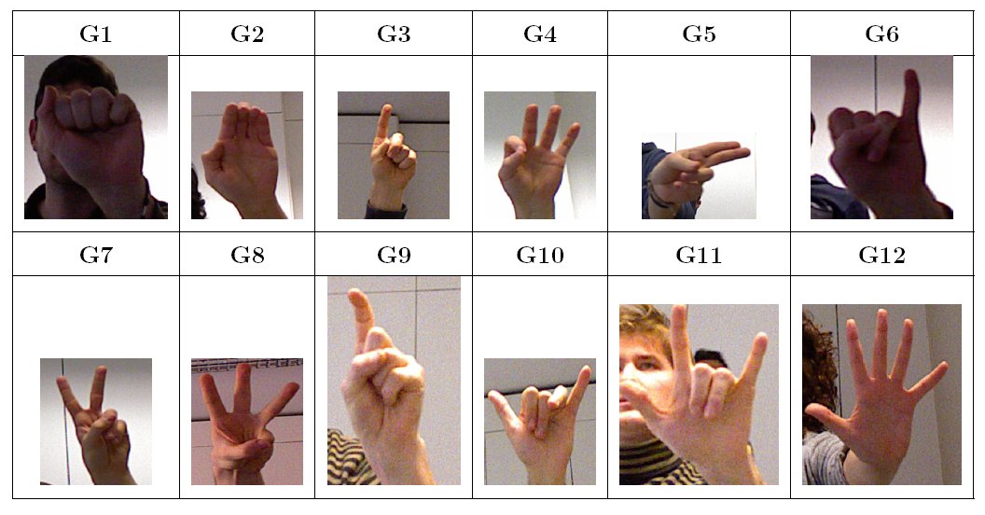
Optical Pattern Recognition

Slide 14
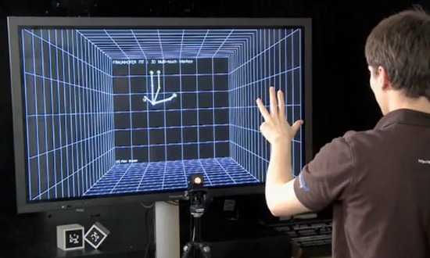
Motion Pattern Interruption

Slide 15
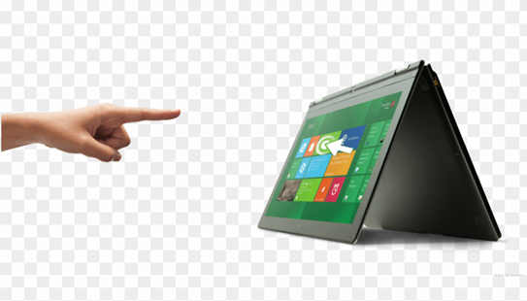
Screen Pointing

Slide 16
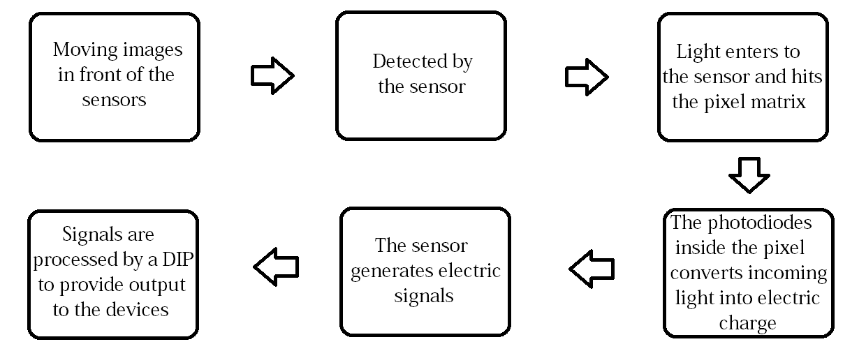
Work Flow

Slide 17
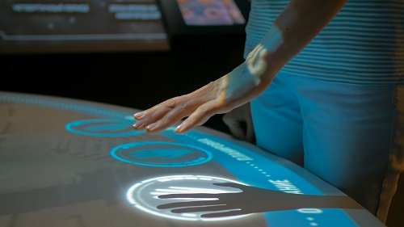
SDK
The Touchless SDK is an open source SDK for .net application.
It enables developers to create multi touch based applications using a web cam for input.

Slide 18
Application Fields
Entertainment
Home Appliances
Institutions
Medical Services
Office
Transport

Slide 19
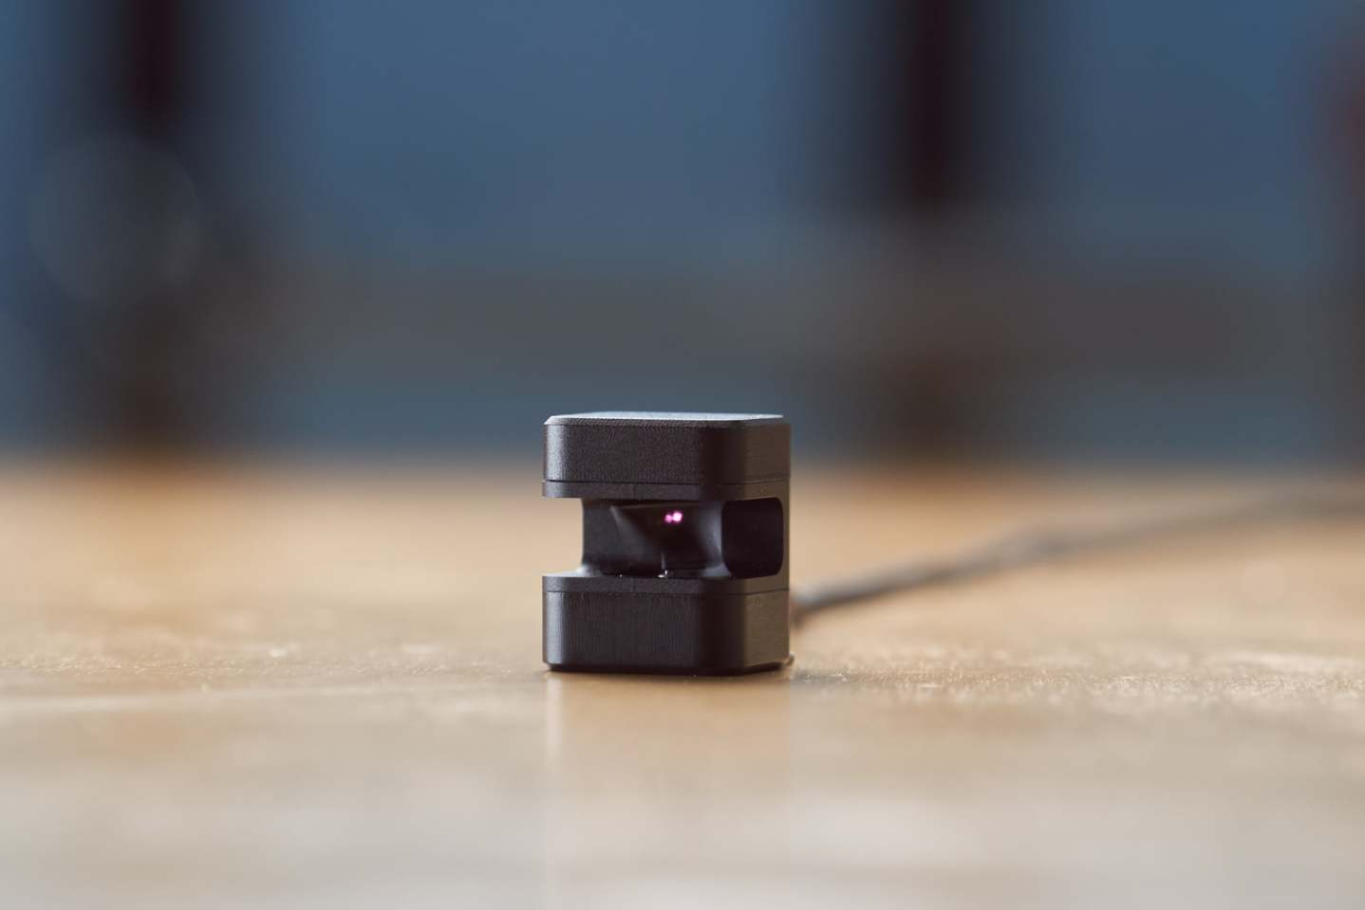
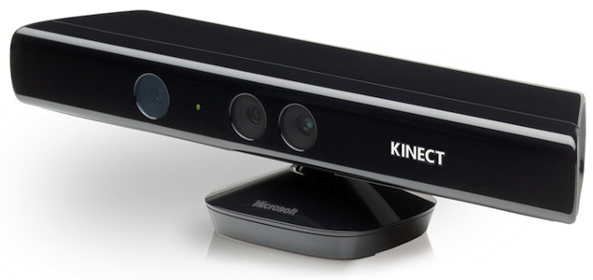
Devices
GLAMOS
MICROSOFT KINNECT

Slide 20
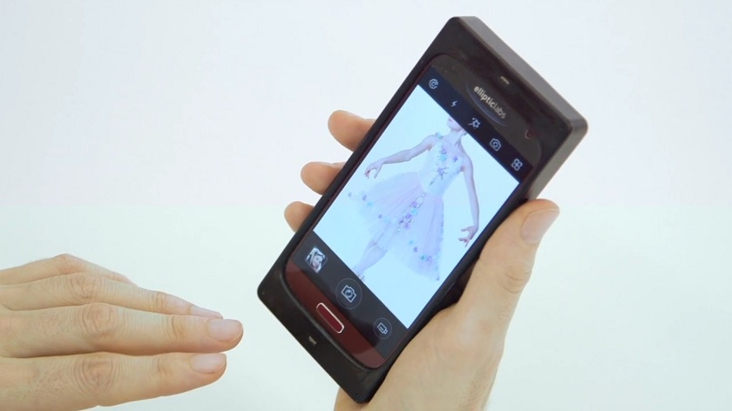
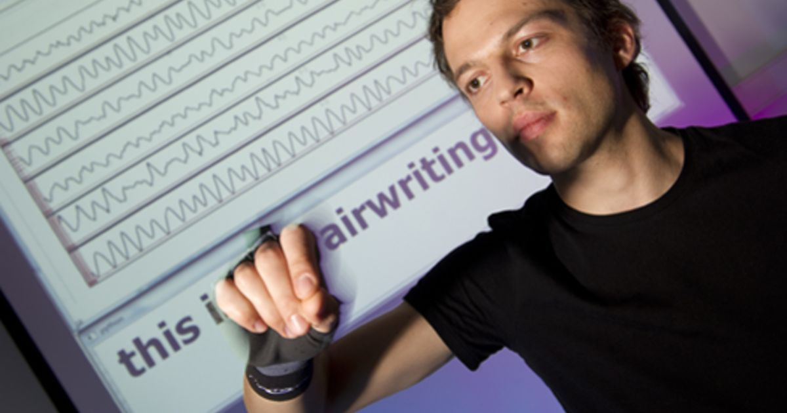
Devices
Elliptic Labs
Air Writing

Slide 21
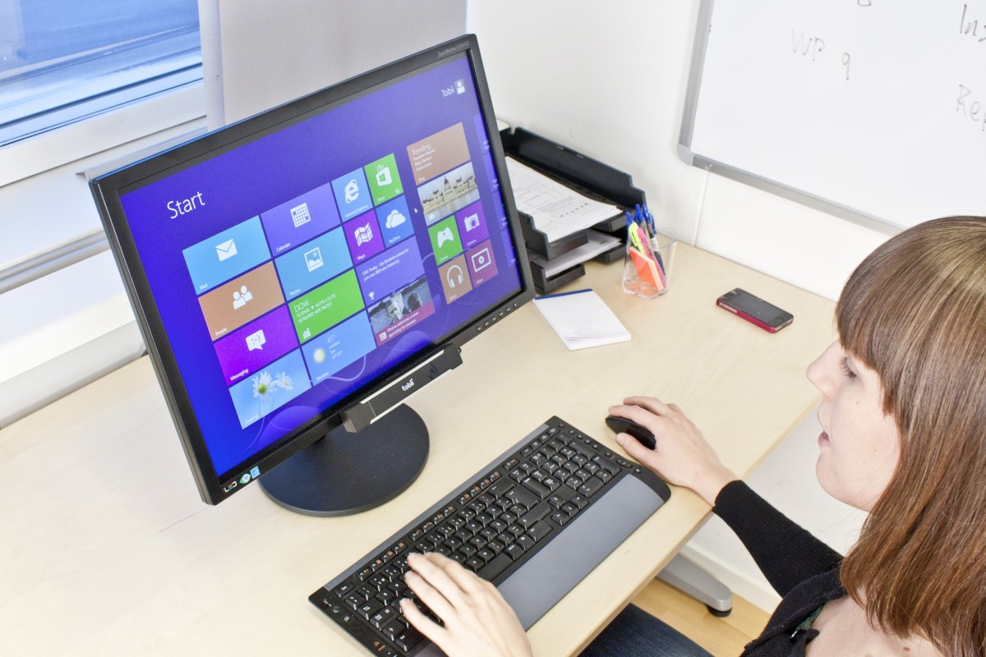
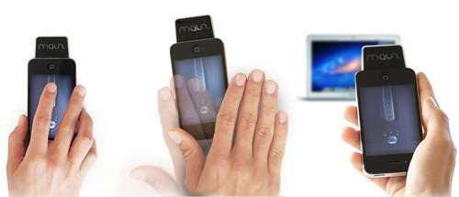
Devices
Tobii Rex
Mauz

Slide 22
Advantages
Hygienic
User friendly
Less maintenance required
Could be operated from a safe distance

Slide 23
Disadvantages
High cost
Slow response
Not so much accurate
Multiple gestures are required for signalling

Slide 24
Conclusion
Undoubtedly the next era will go with touch less touch screen technology. Although this technology is new but it has outstanding demand. From Now on, we do not have to sit in front of a blue screen for a very long time. With this technology, we can control our gadgets from a reasonable distance, Which will be good for our eyes and backbone too.
Soon or later, every monitor, ATM machines, mobile devices will switch to this GBUI technology for better performance and reliability. May be few years down the line, our body can be transformed into a virtual mouse, virtual keyboard.
Most importantly this technology allows us to interact with information through hand gesture so it is also hygienic.

Slide 25
Acknowledgement
I take this opportunity to express my profound gratitude and deep regards to our honorable HOD Sir, Mr. Dhiman Karmakar and Guide Mrs. Puja Mukherjee for her exemplary help for the topic selection, valuable guidance, monitoring and constant encouragement. The blessing, help and guidance given by her time to time shall carry a long way in the journey of my life and carrier on which I am about to embark. Moreover I was glad to work under her guidance.

Slide 26
Bibliography
STUDY OF TOUCH LESS TOUCH SCREEN TECHNOLOGY Nilofar E. Chanda N.B. Navale College of Engineering, Solapur, Maharashtra, India
Survey on Touchless Touch Screen Technology using Hand Gestures Kavitha. G 1 , Veena. M 2 Department of CSE Sapthagiri College of Engineering, VTU, India
Touchless Touchscreen by Anil Navalkishor Gauda and Kamlesh Kapildev Rai, MCA, Institute of Management and Computer Studies, Wagle Industrial Estate, Thane West, Mumbai, Maharashtra, India
Touchless Screen Technology by Ms.Gayatree S.Nakhate and Prof Anup A. Pachghare, IJECSCSE
https://en.wikipedia.org/wiki/Touchscreen
https://www.slideshare.net/Naman8824/touchless-touch-screen
https://studymafia.org/touchless-touchscreen-technology-ppt-and-pdf-report-for-cse/

